Slide 1

Varendra University
Dept. of Computer Science & Engineering (CSE)
Multiplication and Division Instructions (Chapter-9)
Course Title: Microprocessor and Assembly Language
Course No: CSE 3205
Prepared By:
Md. Adnan Sami
Lecturer, Dept. of CSE, VU

Slide 2
Outline
  MUL and IMUL.
  Simple Applications of MUL and IMUL.
  DIV and IDIV.
  Sign Extension of the Dividend.

Slide 3

MUL and IMUL
  MUL (multiply) for unsigned multiplication.
  IMUL (integer multiply) for signed multiplication.
  The syntax is,

Slide 4
MUL and IMUL
  Byte Form:
  For byte multiplication, one number is contained in the source and the other is assumed to be in AL. The 16-bit product will be in AX.
  Word Form:
  For word multiplication, one number is contained in the source and the other is assumed to be in AX.

Slide 5
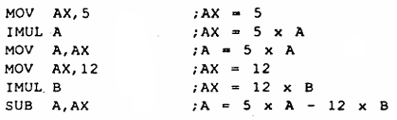
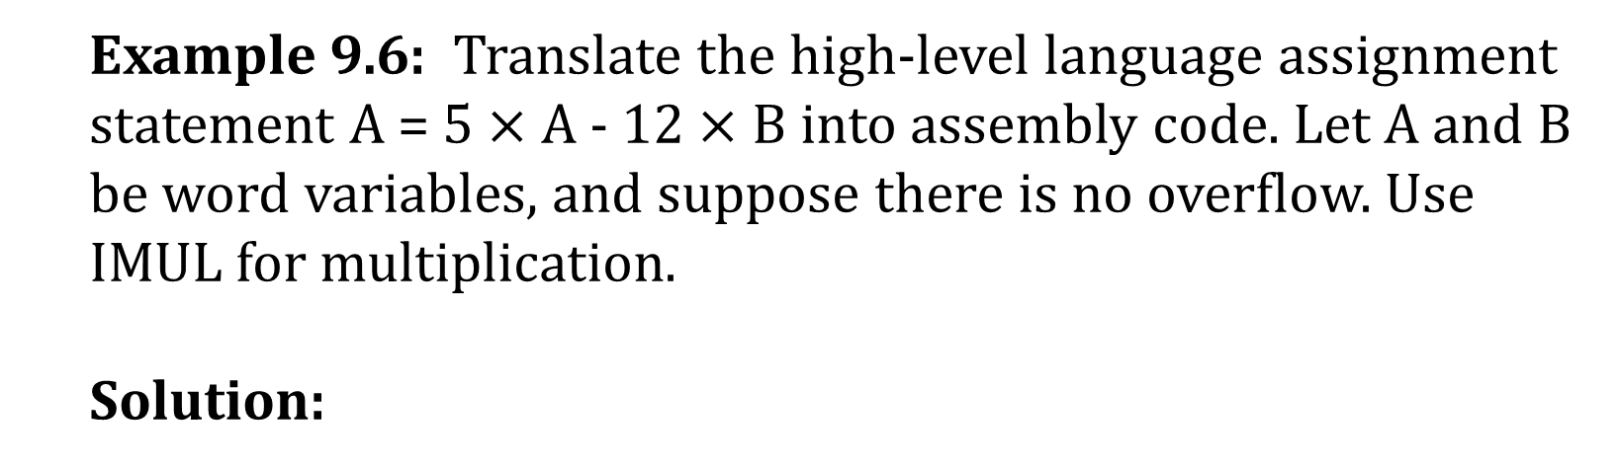
Simple Applications of MUL and IMUL
  Example 9.6: Translate the high-level language assignment statement A = 5 $×$ A - 12 $×$ B into assembly code. Let A and B be word variables, and suppose there is no overflow. Use IMUL for multiplication.
  Solution:

Slide 6
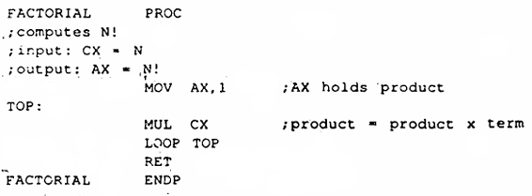
Simple Applications of MUL and IMUL
  Example 9.7: Write a procedure FACTORIAL that will compute N! for a positive integer N. The procedure should receive N in CX and return N! in AX. Suppose that overflow does not occur.
  Solution:
  CX is both loop counter and term.

Slide 7

DIV and IDIV
  When division is performed, we obtain two results,
    Quotient.
    Remainder.
  DIV (divide) is used for unsigned division.
  IDIV (integer divide) for signed division.
  The syntax is,

Slide 8
DIV and IDIV
  Byte Form:
  In this form, the divisor is an 8-bit register or memory byte.
  The 16-bit dividend is assumed to be in AX.
  After division, the 8-bit quotient is in AL and the 8-bit remainder Is in AH.
  Word Form:
  Here the divisor is a 16-bit register or memory word.
  The 32-bit dividend is assumed to be in DX:AX.
  After division, the 16-bit quotient is in AX and the 16-bit remainder is in DX.

Slide 9

Sign Extension of the Dividend
  Example 9.12: Divide -1250 by 7.
  Solution:

Slide 10

Sign Extension of the Dividend
  Example 9.13: Divide the signed value of the byte variable XBYTE by – 7.
  Solution:
  There is no effect of CBW and CWD on the flag.

